Slide 1
The Swedish Higher Education Sector
April 2017
KTH
Lennart Ståhle

Slide 2
What is a University?
The ”Guild nature of” mediveal European universities:
The word ”university” ”universitas” in mediveal latin means ”guild” and a correct translation of ”universitas magistrorum et scolarium” is the ”guild of teachers and students”.
Early universities up to 1800 were education institutions.
Research is introduced relatively late in the university system.
Is the 200 year ”Berlin contract” of freedom of speech, teaching and research is it thereatend by the moves toward more autonomy?

Slide 3
University autonomy – academic freedom
University autonomy refers to the governace of the institution. In the European debate it ususally refers to autonomy from the state.
Academic freedom refers to postion of the individual teacher and or resercher with in the system.
An autonomus institution can threaten the academic freedom but so can also centrally governed institution.

Slide 4
The Swedish higher education sector
14 Universities
14 UniversityColleges
4 Art Colleges
13 ”Semi-private” institutions
There is no formal accreditation of institutions. The government decides about the foundation of state institutions.
The Swedish Higher Education Authority decides about accreditation of degrees.

Slide 5
Higher education institutions - universities
14 universities
A university is a HEI that has been given the right to award doctoral degrees in all subjects and at all faculties. A university has also consequently the right to award bachelors and masters degrees in all subjects and at all faculties.
Universities have also the right to award professional degrees according the decision of The Swedish National Agency for Higher Education

Slide 6
University colleges
14 University colleges (UC)
A University college is a HEI that has been given the right to award degrees a undergraduate level.
UC´s have also the right to award professional degrees according the decision of The Swedish Higher Education Authority.
They have also the possibility to award PhD´s within a defined area of research.

Slide 7
Colleges of art
4 University colleges of Art. All situated in Stockholm
Speccialised in one art form each: dance, music, paniting, opera, crafts / design, and film / radio/ television production
They have all right to award a Bachelors and a Masters degree in art
Small in number of students 600 - 35
Art education is also carried out at some universities and university colleges.

Slide 8
Students
The Sector is still growing when it comes to number of students, staff and economy.
357 000 students at first and second cycles programmes and 70 000 degrees
19 000 students at third cycle (PhD programmes) and 3 300 2 500 PhD degrees

Slide 9
”Semi – private” instituions
13 institutions of varied size
Two of them former state institutions: Chalmers Institute of Technolgy and The University College of Jönköping
One: Stockholm School of Business is the oldest independent HE institution
10 rather small institutions: 2 nursing schools (belonging to The Red Cross and a private hospital, 1 design school and 7 schools closely connetected to religious (Christian) churches.
They have the right to award specific degrees according to the Higher Education Ordinance after application to the goverment and accreditation.

Slide 10
Staff
Research and teaching staff: 29 200
5 089 professors - 25% vomen
8 581 senior lecturers - 46% women

Slide 11
Students
343 344 students - 60% women, 40% men.
18 433 PhD students - 47% women, 53% men.

Slide 12
The Bolognadeclaration
The degree structure should be transparent and internationally comparable
The degree struture should be divided in two/ three cycles
ECTS should be introduced to enhance student mobility
Obstsacles for mobility of students and staff should e removed
The European cooperation in quality assurance should increase
The European dimension in Higher Education

Slide 13
First cycle:
University Diploma (120 ECTS)
University Diploma In Fine Arts
Bachelor (180 ECTS)
Bachelor in Fine Arts
20 Professional Degrees (120 – 180 ECTS)

Slide 14
Second cycle:
Master (60 ECTS)
Master (60 ECTS) in Fine Arts
Master (120 ECTS)
Master (120 ECTS) in Fine Arts
15 Professional Degrees (60 and 120 ECTS)

Slide 15
Third cycle
Licentiate degree (2 years)
Doctoral degree (4 years)

Slide 16
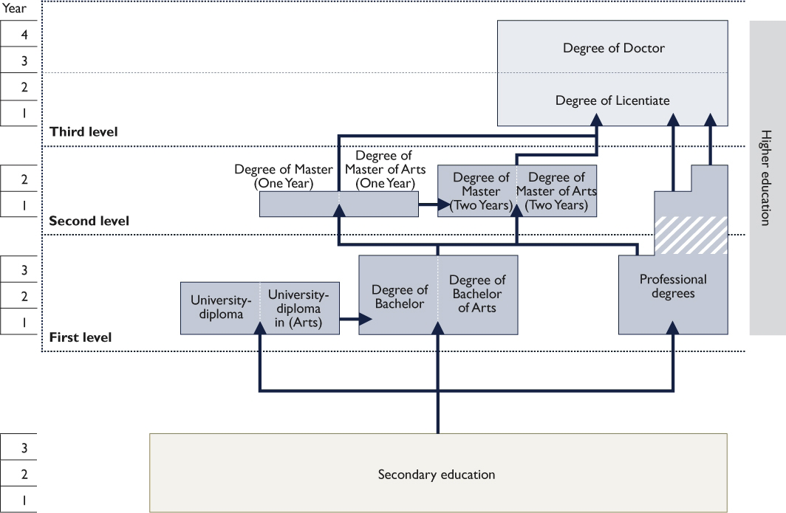
The degree system and Bologna process

Slide 17
Every degree has a ”standard”, decided by thr government in an annex to the Higher Education Ordinance.
The standard consists of
- a general discription ”Scope”
- Outcomes
- Knowledge and understanding
- Competence and skills
- Judgement and approach
- Independent project (degree project)

Slide 18
The degree diploma should contain:
The name of the degree
The level of the degree
The courses
The name of the Higher Education Institution where the courses have been examined
A Diploma supplement should be attached to the degree diploma

Slide 19
Higher education degrees
46 887 General degrees (Diploma, Bachelor and Master)
1 815Diploma 56% women - 44% men
28 475 Bachelor 64% women - 36% men
16 607 Master 47% women -53% men
972 Art degrees 59% women - 41% me
33 014 Professional degrees 67% women – 33% men
2 835 PhD degrees 47% women – 53% men

Slide 20
Governance state institutions
Higher Education Act (decided by the parliamnet)
Higher Education Ordinance (decideed by the government)

Slide 21
Funding – state institutions
It is the parliament, after proposal from the government (MOE), who decides about the budget to the institutions.
Student numbers and performance determine funding for undergraduate teaching. The oucomes of quality evaluations are also an important factor.
Fundin postgraduate programmes and research performanceindicators: publications, external funding.

Slide 22
Governance – governing body
All institutions must have a governing board of 15 persons:
8 members appointed by the government after suggestion form the HEI (rector)
3 representatives of the academic staff
3 representatives of the students and
The rector

Slide 23
The governing board decides about:
The over all budget of the institution
The organisation
Budget proposals to the government
The annual report and
Proposal for the position as rector
The board has no influence in academic matters

Slide 24
Governance ”semi – private” institutions
No regulations from the state except for admission rules.
Annual contract with the state about their education (according to HEO) and the reimbursement for their accreditated education.

Slide 25
Quality Assurance – Why?
Increasing competition nationally and internationally
Expectations from stakeholders
The rapid growth of Higher Education and investment in HE demands that quality must be shown
International mobility and recognition of degrees

Slide 26
Quality
Quality of a course
Quality of a programme
Quality of a degree
Quality of an institution
HOW CAN YOU PROVE QUALITY?
Quality assurance’ is a generic term in higher education which lends itself to many interpretations: It is not possible to use one definition to cover all circumstances.

Slide 27
It is you as a HEI that have the responsibility to develop your own quality assurance system.
To prove quality you must show that you have developed an internal quality assurance process.
You must show that your institution contiuning work with quality assurance questions and
That this work is developed at all levels in the institution.

Slide 28
External Quality asuurance
Carried out by an external independent body
Diffirent ways to organise the quality assurance nationally.
In Sweden the government has given the task to the Swedish Authority of Higher Education.

Slide 29
The Swedish case
Four pahses/ cycles of QA.
QA is focussed on education and teaching.
The institutions do carry out evaluation of research and administration.
A modern quality assurance system includes all aspects of the operations of the institution.

Slide 30
First phase
Quality assurance and evaluation was introduced in 1993. The office of the University Chancellor (UC) was given the task.
Evaluation of quality assurance systems of the institutions.
- Self evaluation
- External panel with students
- Written report to the UC with recommendation.
- Decsion by the UC: acceptable or non acceptable. Good examples.

Slide 31
Second Phase
QA system based on accreditation and control.
The system looked into the prerequisites and processes:
- Teacher competence including gender composition
- Physical facilities
- Internationalisation
- Teaching methods
Thematic studies: internationalisation, equuality, student participation etc.

Slide 32
Important components:
- Self evaluation
- Peer review
- Site visits with interviews
- Written report to the UC
If quality was considered to be in danger or insuffcient the right to award a degree could be withdrawn.

Slide 33
Third phase
Three main components:
Granting degree awarding powers (accreditation)
Evaluation of study programs and courses leading up to a degree.
Evaluation of PhD programs should be included.

Slide 34
Peer review with assessment panels:
Subject experts
Students
Representatives from working life

Slide 35
The students’ degree projects
Self-evaluations of higher education institutions
Student experiences
Questionnaires sent to alumni
Web based interviews (Site visits)

Slide 36
The result of the assesment:
The panel of assessors should give an overall appraisal of the study programme’s quality on a three-level scale:
  Very high quality
  High quality
  Inadequate quality
The formal decision is made by the University Chancellor.

Slide 37
If the assessment of a study programme reveals inadequate quality, the HEIs right to award the degree is questioned.
Follow-up after one year.
If no improvement – The Agency withdraws the HEIs right to award the degree.

Slide 38
Fourth phase
Examination of the quality assurance system for education
Accreditation of new programmes
Review of existing programmes
Thematic reviews
Proposal from the government:
Evaluation of research

